Slide 1
Quantum Probability
By Mac

Slide 2
Classical
Uncertainty
=
Ignorance
=
Probability
Imagine flipping a coin, the reason it’s 50/50 is because you don’t know the exact angular velocity, air resistance, friction etc..
Quantum
Uncertainty
=
Probability
≠
Ignorance
The more precisely you measure momentum (velocity) the less precisely you know position.

Slide 3
Classical
Probability is [0,1]
Probability sums to 1
Quantum
Probability is |amplitude|²
Probability sums to 1
Yes probability is a complex number, as there is both magnitude and phase.

Slide 4
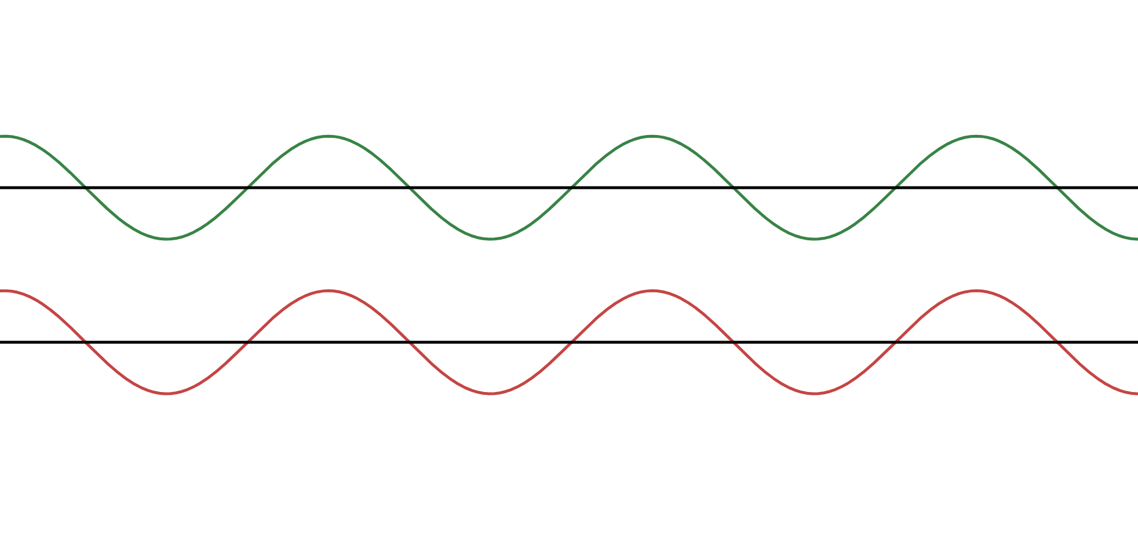
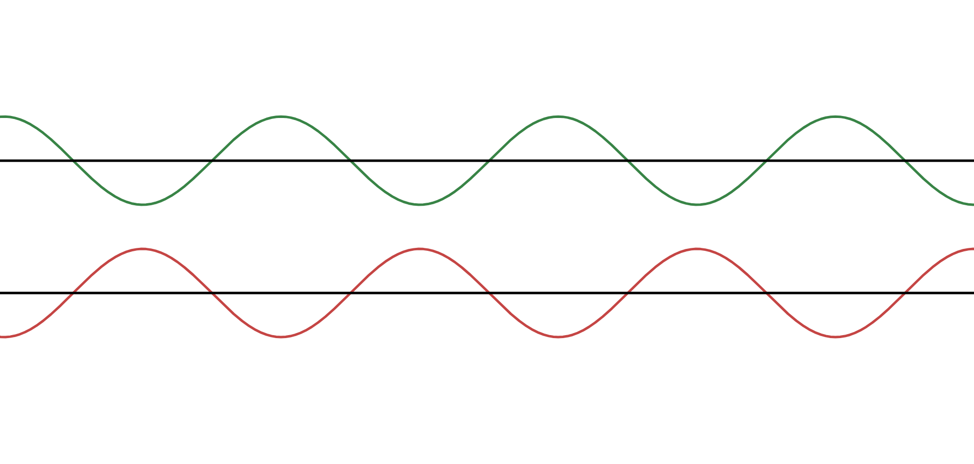
|(a+bi)+(c+di)|² ≠ |a+bi|² + |c+di|²
|(a+bi)+(c+di)|²=|(a+c)+(b+d)i|=√(a+c)² + (b+d)²
This means there can be interference–like waves…

Slide 5
What is a wavefunction?
A wavefunction ψ(x) assigns an amplitude to each position x
The probability of finding the particle at x is given by |ψ(x)|²
But ψ(x) is continuous, so ψ(k) = 0 …

Slide 6
Integration!!!

Slide 7

Integrating Probabilities!!!
P(x to x+dx) = |ψ(x)|²dx
This means ψ(x) is not a probability, but a probability density function (PDF)
https://www.desmos.com/calculator/i5zrlna9ci

Slide 8

Expected Values

Slide 9
THANKS FOR LISTENING
MERCI DE VOTRE ÉCOUTE
GRACIAS POR ESCUCHAR
सुनने के लिए धन्यवाद
DANKE FÜRS ZUHÖREN
感謝您的聆聽
ご清聴ありがとうございました
DZIĘKI ZA SŁUCHANIE
들어주셔서 감사합니다
MULȚUMESC PENTRU ASCULTARE
شكرا على الاستماع
СПАСИБО ЗА СЛУШАНИЕ

